Slide 1


Enable Scale and Aspect Ratio Adaptability in Visual Tracking with Detection Proposals
Enable Scale and Aspect Ratio Adaptability in Visual Tracking with Detection Proposals
Dafei Huang, Lei Luo, Mei Wen,
Zhaoyun Chen, Chunyuan Zhang
College of Computer, National University of Defense Technology
National Key Laboratory of Parallel and Distributed Processing
Notes:
- Good morning, everyone. I am Dafei Huang from NUDT, and here I will introduce our new method to estimate the target’s scale and aspect ratio in Visual Tracking task.

Slide 2
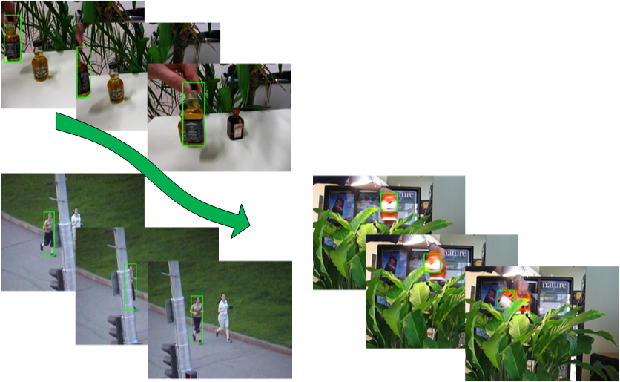
Visual tracking problem
Scale Variation, Out-of-View
Non-Rigid Deformation, Occlusion
Rotation, Motion Blur
and etc.
Notes:
- The task of Visual tracking, or object tracking more straightly, is that,
provided with some initial target information,
to estimate the status of one or more target objects along a video.
Our work concentrates on the most common scenario, that is to track a single target and represent target status using a rectangular bounding box.
- as shown in these 3 frame seqs, we can perceive some baffling/'bæflɪŋ/ factors in tracking tasks. Moreover, the need to accurately estimate the scale and aspect ratio of target makes the problem even harder.

Slide 3
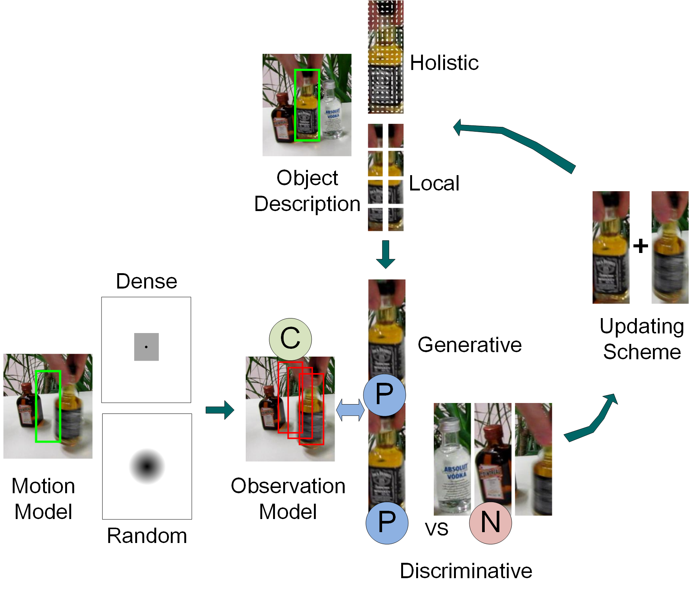
Visual tracker structure
Notes:
- Generally, an object tracker composes of 4 modules
- The object description is responsible for describing the current target appearance, and there are 2 main kinds of description methods. The holistic method tries to describe the target with a whole feature patch, while the local method split the appreance into several local patches that forms a dictionary.
- The motion model is used to draw candidates around the previous location. A dense model will traverse all the possible candidates, and random method will sample candidates according to some probability distribution.
- The observation model is used to evaluate candidates according to the object description, and find out the one containing the target. A discriminative model explicitly considers the difference between positive and negative examples, while the generative model only tries to find the candidate that matches the positive example best.
- Since the target appearance always changes, we need an updating scheme/skim/ to update the object description using the newly-found target.

Slide 4
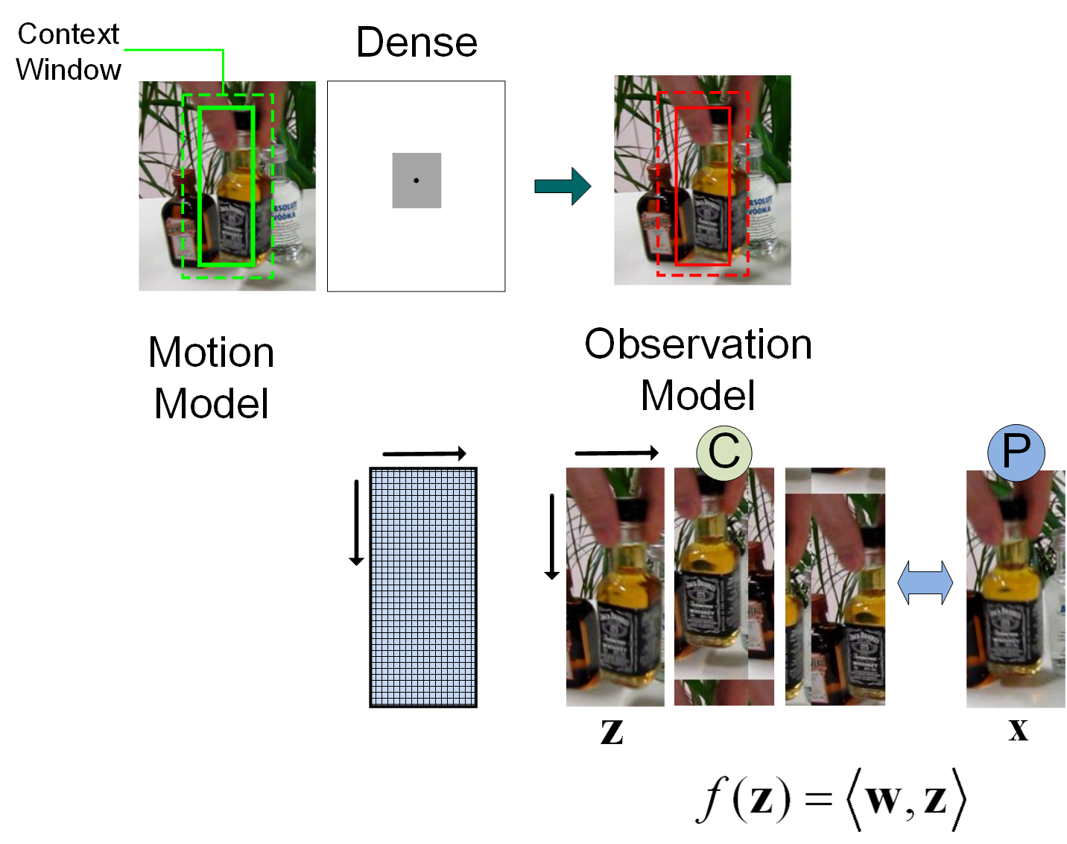
Correlation filter tracker
Notes:
- Although trackers become more and more complicated, recently proposed correlation filter trackers have achieved appealing performance despite their great simplicity and superior speed.
The most essential feature of the correlation filter tracker is its motion model. After enlarging the bounding box to form a context window (shown by the green dashed box), the patch within the context window is cyclically shifted and each shifted patch is used as a candidate.
The corresponding observation model is a simple linear model, which is the inner product of a candidate patch z and a coefficient matrix w.
The inner product, or the response of the observation model, \f_of_z, shows the probability of patch z containing the target.

Slide 5
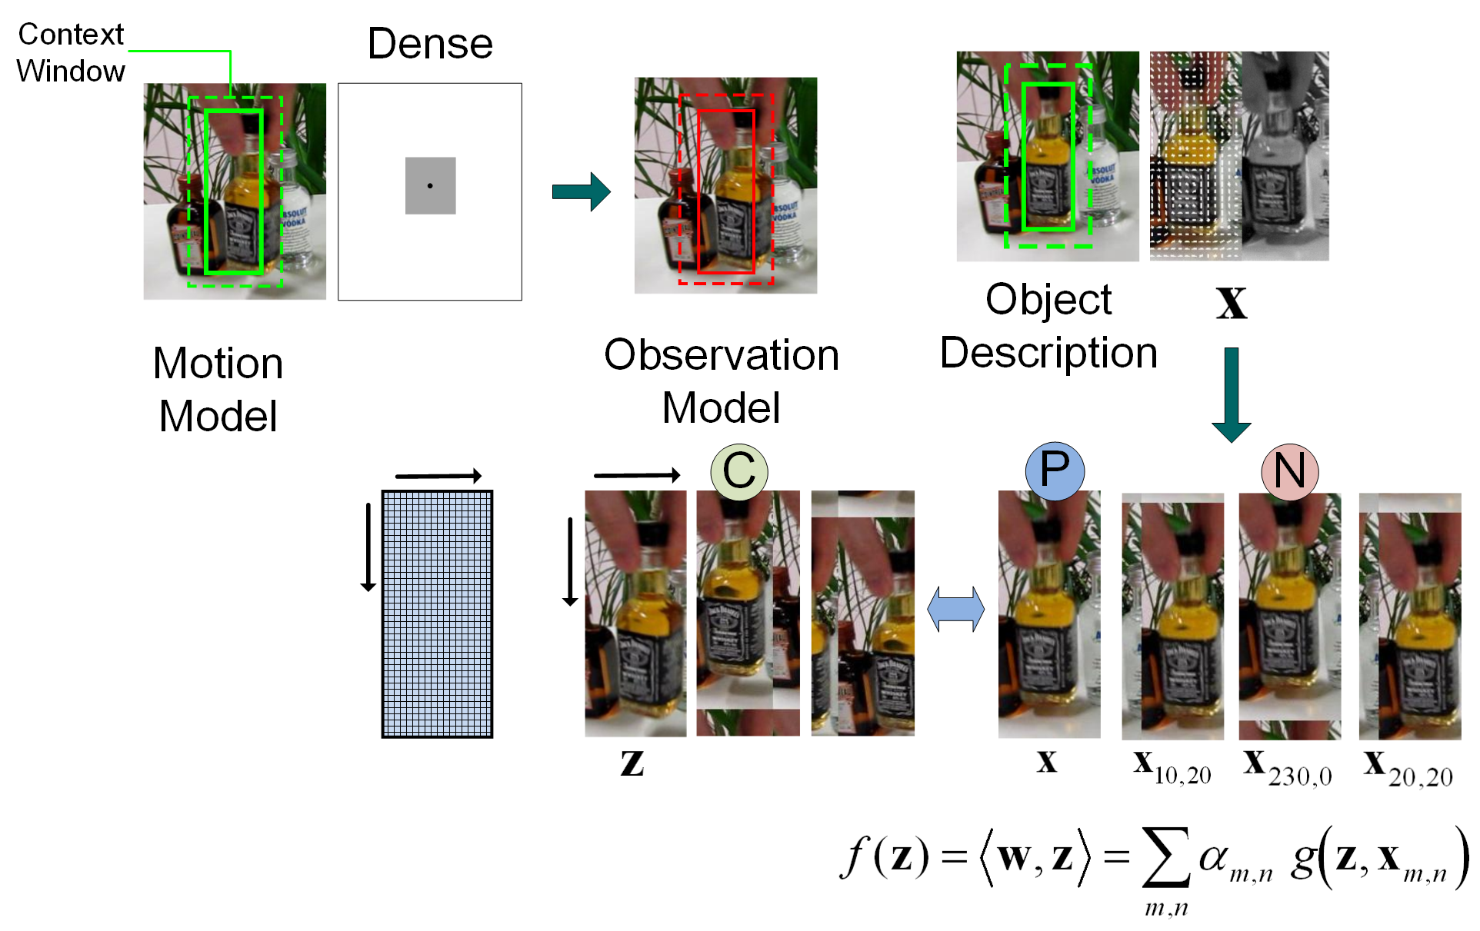
Correlation filter tracker (KCF)
João F. Henriques, et al. TPAMI2015
Notes:
Our work is based on a typical correlation filter tracker called KCF, which introduces Gaussian kernel(denoted by \g) and reformulate the linear model in dual space.
KCF trains the reformulated linear model by solving a Ridge Regression problem, and all the cyclically shifted object descriptions (denoted by \xmn) are used as the training set.
- Therefore here the observation model considers all the shifted descriptions as negative examples, and becomes a discriminative model.

Slide 6
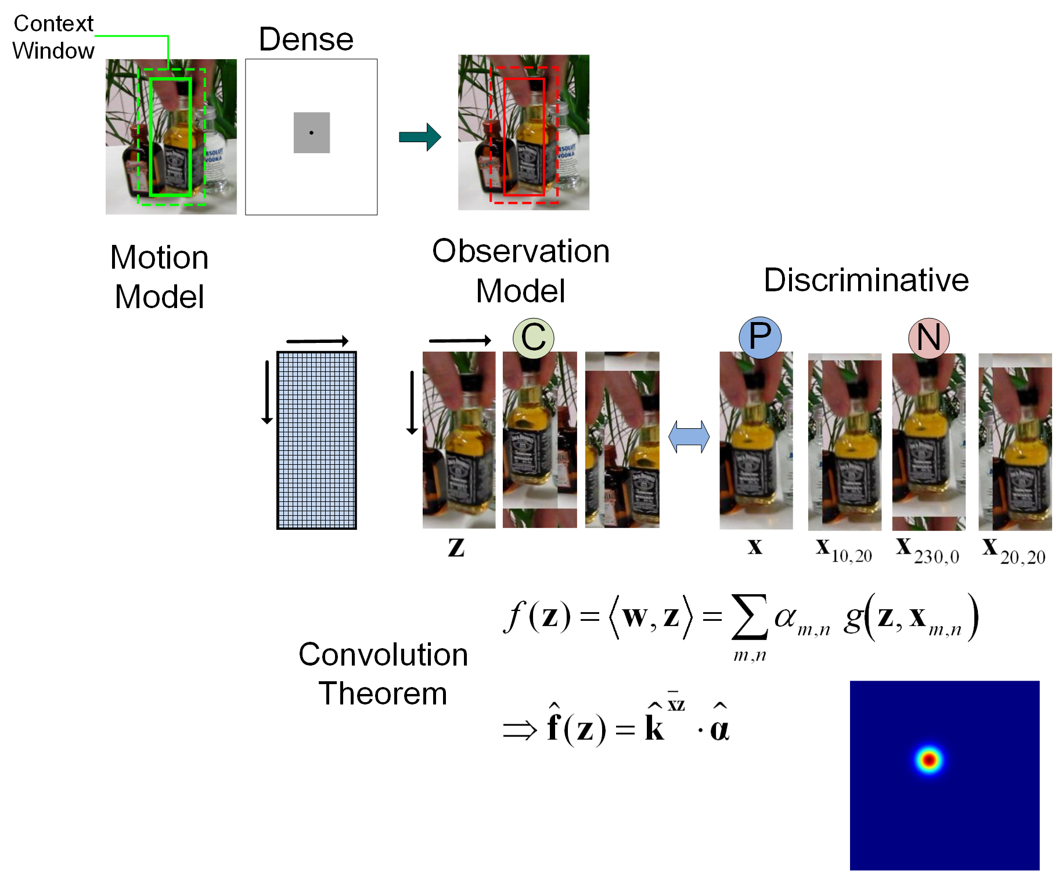
Correlation filter tracker (KCF)
Translation
Notes:
- Thanks to convolution theorem, there is no need to evaluate candidates one by one, but can calculate all their responses together efficiently.
According to the peak location in the response matrix, denoted by \f_of_z) in bold/bold/, the translation of target center can be obtained.
However, there is still no hint for target’s size, so KCF cannot track the scale and aspect ratio change.

Slide 7
Correlation filter tracker (KCF)
Translation
Notes:
After the new target location is found, since the coefficient matrix \alpha is related to the current object description, KCF has to update them both.

Slide 8
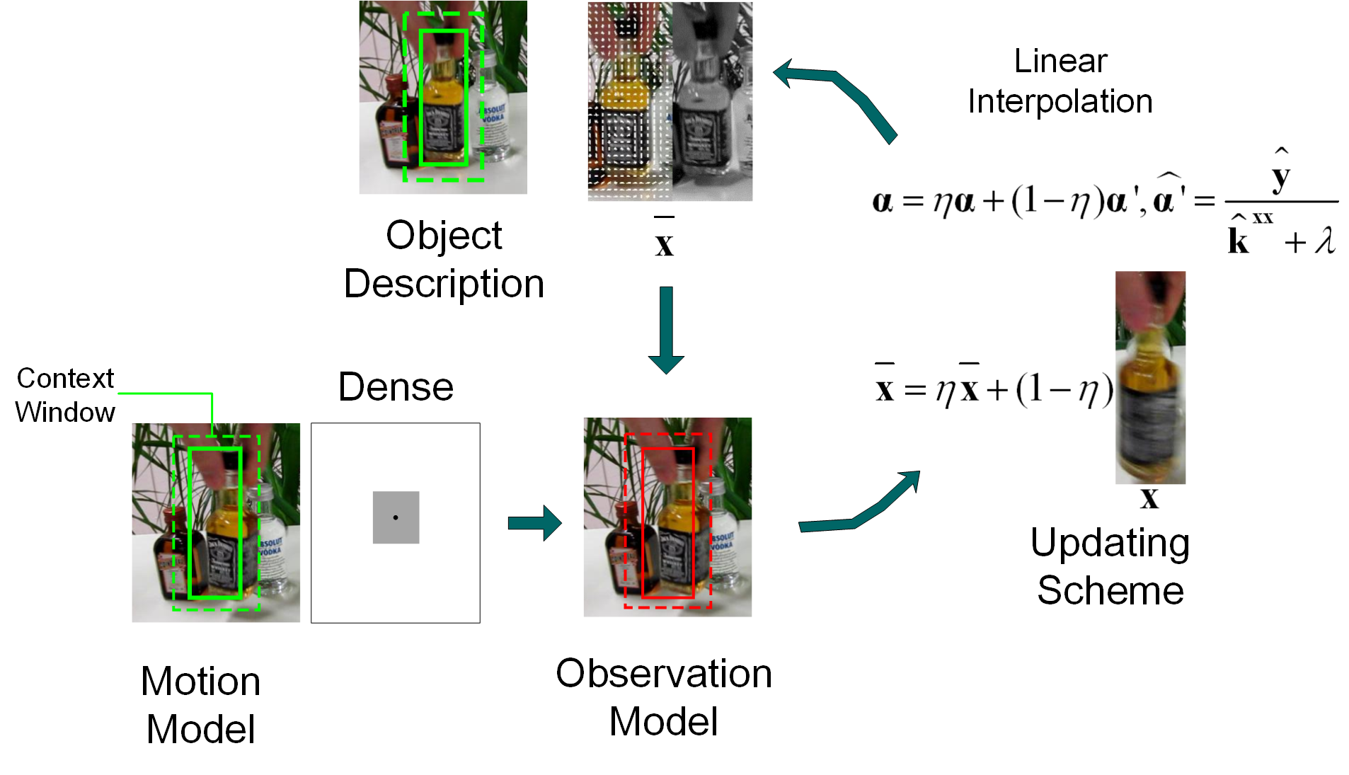
Correlation filter tracker (KCF)
Notes:
The updating scheme of KCF is simple linear interpolation. The new target appearance \x and the re-trained coefficient matrix \alpha_prime are both linearly interpolated.

Slide 9
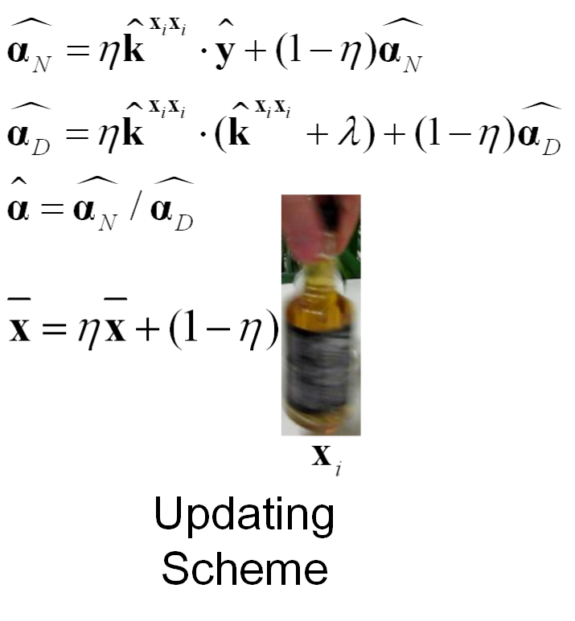
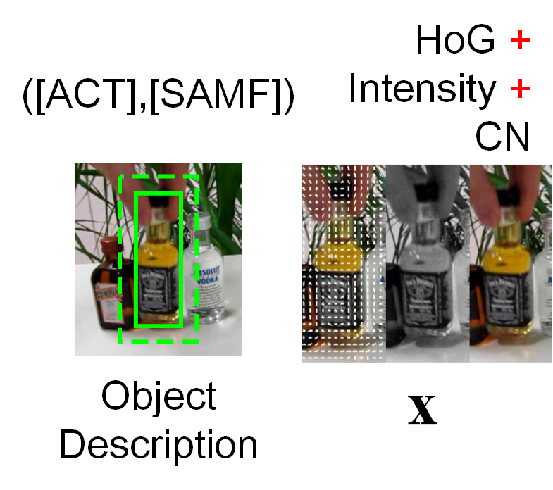
Feature integration and robust updating
different scales and aspect ratios
the number of distracting
candidates
more precise and robust discriminative correlation filter
Update the numerator and denominator separately ([ACT])
Notes:
- Unlike KCF, our tracker considers different target scales and aspect ratios, which will induce more distracting candidates, so a more precise and robust correlation filter is needed.
- Thus we extend the feature used in original KCF to a combination of HOG, intensity, and color naming, similarly to the ACT and SAMF tracker.
- The robust updating scheme in ACT is also adopted, where the numerator and denominator/dɪ'nɑmə'netɚ/ of \alpha are updated separately.

Slide 10
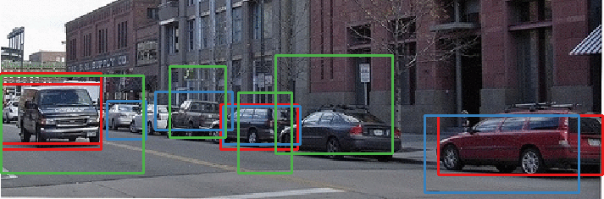
Detection proposals
Hosang et al. BMVC2014
Efficiency: to avoid performing classification on numerous windows.
Accuracy: to reducing false positives before classification.
Notes:
-In another area, object detection, detection proposal generators are widely used to pick out candidate regions that may contain an object.
-And we will show that, Detection proposals can not only boost efficiency and accuracy in object detection,
But also enable scale and aspect ratio adaptability in visual tracking as a supplement to motion model.

Slide 11
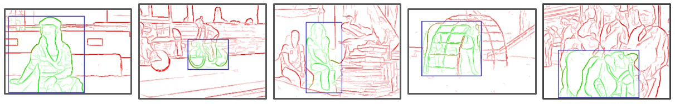
Detection proposals (EdgeBoxes)
The number of contours that are wholly contained in a bounding box is indicative of the objectness
Zitnick et al. ECCV2014
Sliding window + Scoring each BB:
contour wholly contained
Fast
Generic
Suitable
Controllable
edge response
size penalization
ignore central area
Notes:
-The proposal generator adopted here is EdgeBoxes. It innovatively/'ɪnəvetɪv/ assumes that the more contours/'kɑntʊr/ a bounding box contains, the more likely the box contains an object.
-EdgeBoxes traverses the whole image in a sliding window manner, and scores every sampled bounding box according to the equation shown here.
-We choose EdgeBoxes for 4 reasons:
Firstly It is fast,( and considering the smaller detection scope in a tracking task, it is even faster. )
It is also class-agnostic/æg'nɑstɪk/ and no pre-learning is needed.
Most importantly, Contours as its objectness measurement, are also important hints for the whereabout and size of the target. So it is intuitively suitable for tracking.
Last but not least, it provides plenty of parameters that can be tuned to control the sliding manner and scoring criterion, thus it’s controllable.

Slide 12
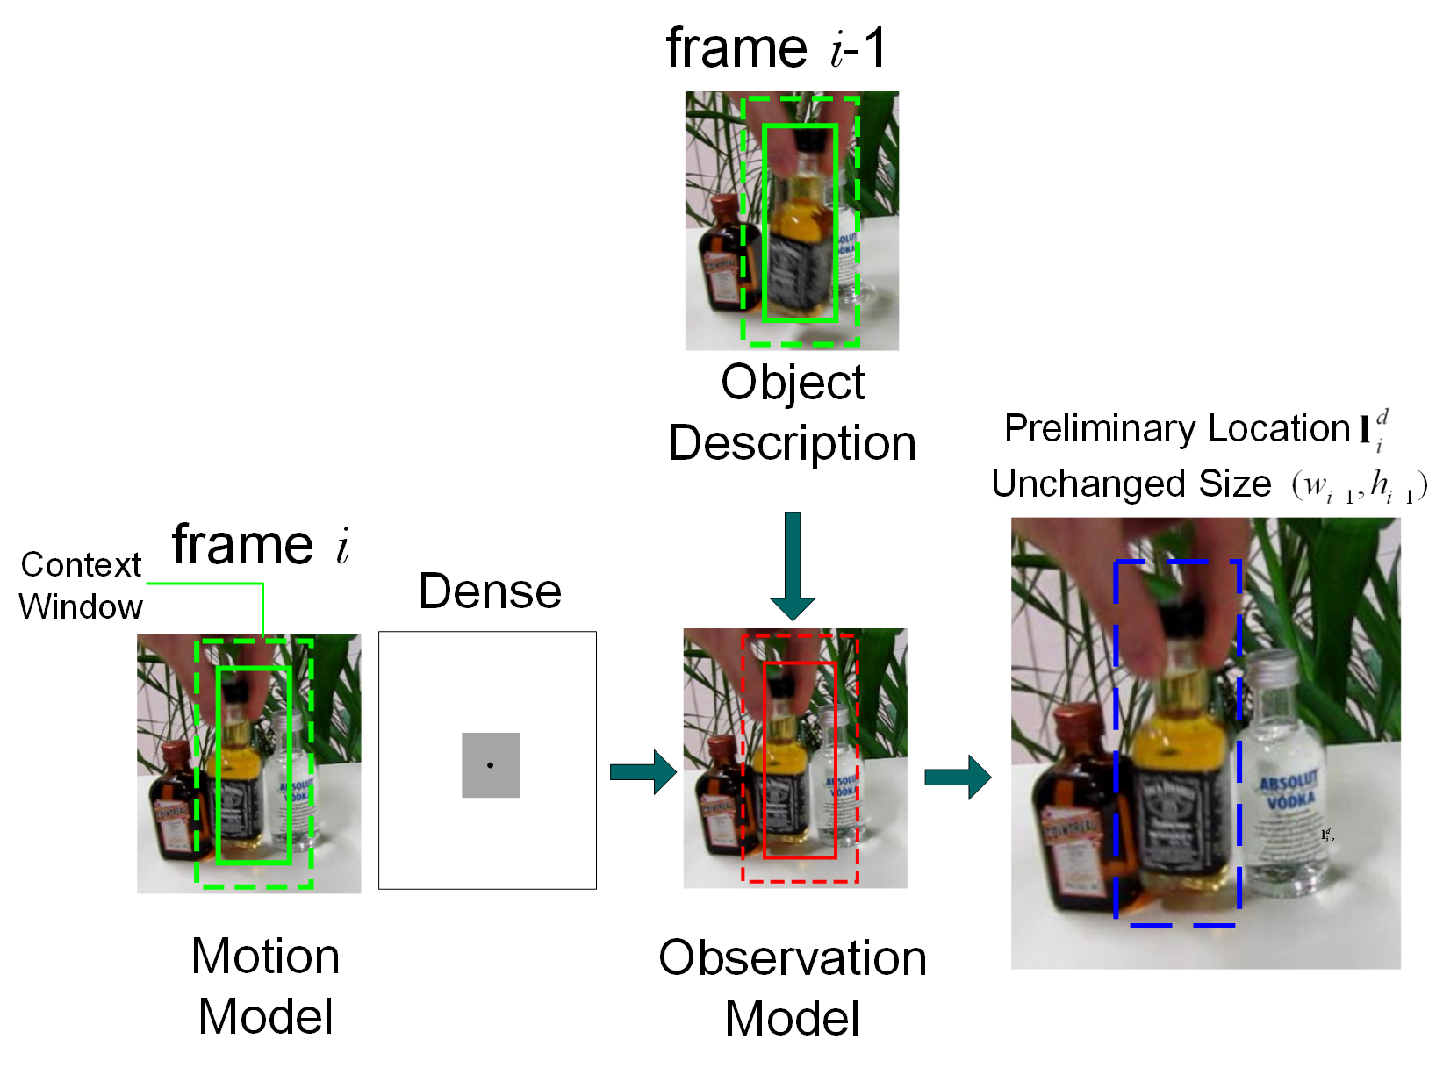
Integrating detection proposals into tracking
Preliminary
translation
estimation (KCF)
Notes:
-Now I’ll talk about how to integrate the proposal generator.
-Firstly, we utilize the KCF pipeline mentioned earlier, to estimate the preliminary/prɪ'lɪmɪnɛri/ location, neglecting the size change. The result is denoted/dɪ'not/ by the blue dashed bounding box.

Slide 13
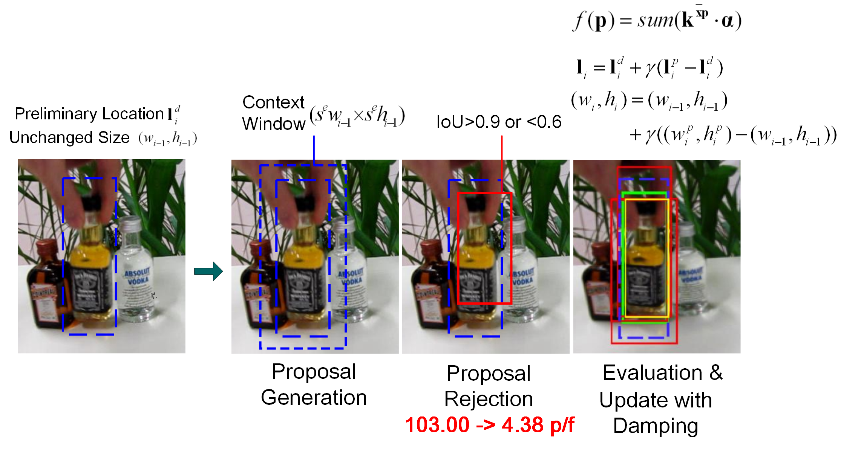
Integrating detection proposals into tracking
Location refinement
& size update
Notes:
-in the left most figure, we can see that the previous size is slight larger than the current target size. So we need to update the size as well as refine the location.
-firstly, we slightly enlarge the preliminary/prɪ'lɪmɪnɛri/ target box to form a new context window and perform EdgeBoxes on it. Then we obtain a large number of proposal boxes.

Slide 14
Integrating detection proposals into tracking
Location refinement
& size update
Notes:
-For those proposals, we perform proposal rejection to get rid of unpromising ones.
-If the overlap ratio, measured by the Intersection over Union, between a proposal box and the preliminary target box is larger than 0.9 or smaller than 0.6, the proposal will be rejected.
-larger than 0.9 means the proposal is almost the same as preliminary target, and the proposal with IoU smaller than 0.6 may be a false proposal or contains other objects.
-Through proposal rejection, the average number of proposals per frame decreases from 103 to about 4.

Slide 15
Integrating detection proposals into tracking
Location refinement
& size update
Notes:
-We then use the equation above the yellow line to evaluate each proposal surviving from the rejection one by one.
-In the right most figure, the red boxes are proposals being evaluated, and the yellow box denotes the proposal with highest response.

Slide 16
Integrating detection proposals into tracking
Location refinement
& size update
Notes:
-Since the proposal is not always that accurate, and to prevent the result from varying abruptly/ə'brʌptli/, we update the location and size using a damping factor.
-again in the right most figure, green box shows the final detected target box, which is between the best proposal in yellow, and the preliminary target box in blue.

Slide 17
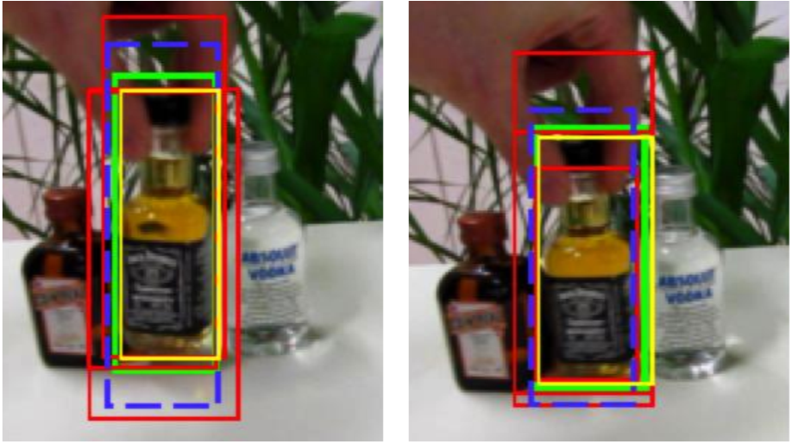
Integrating detection proposals into tracking
Size update
#1574
#1579
Notes:
-Here we can see the size updates more clearly.
-when the target size variation slows down, the disparity between the preliminary target box and the best proposal will decrease.
-Then the final detected box will converge and enclose the target accurately.

Slide 18
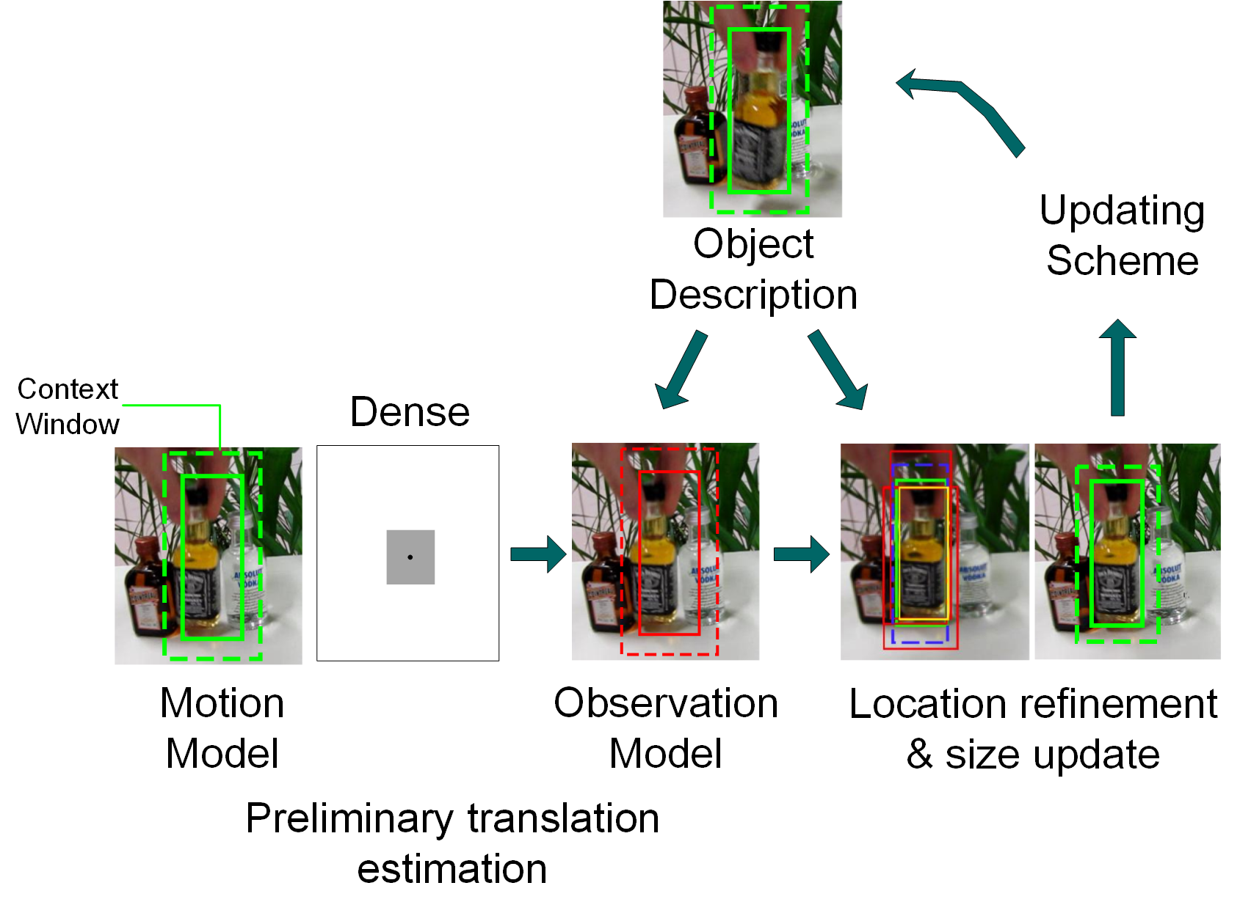
Integrating detection proposals into tracking
Notes:
Here is the complete flow chart of our tracker.
A location refinement and size update module is added, where the scale and aspect ratio change is handled.

Slide 19
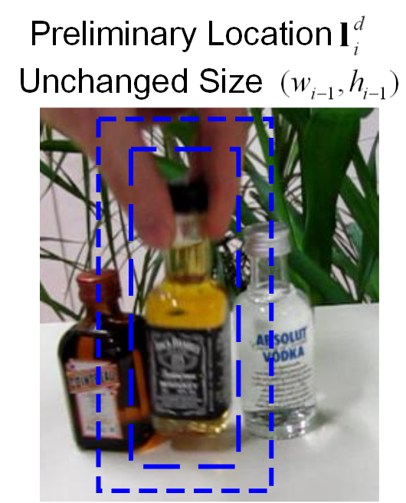
Parameter Setup
EdgeBoxes: to accelerate proposal generation and eliminate false proposals in early stage.
Step length of sliding window
Sliding window bounds
Size penalization
size penalization
ignore central area
Notes:
-The parameters of EdgeBoxes are well tuned to guarantee efficiency.
-We use the parameter setup for an Expected IoU of 0.7, which will increase the sliding step length, but also provide reasonable proposal accuracy.
-The area and aspect ratio range for sliding window are set dynamically according to the current target size.
-And The \kappa, which is used to penalize larger boxes, is decreased, because the target commonly forms the majority of the context window.

Slide 20
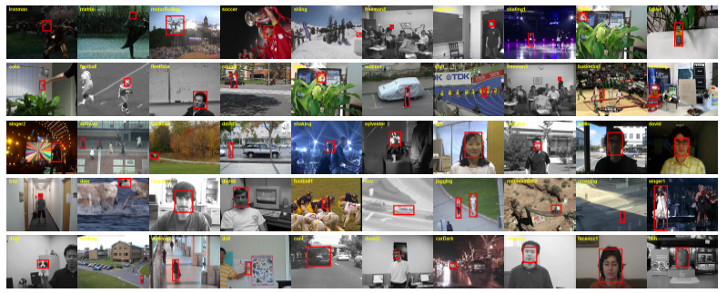
Evaluation
Wu et al. CVPR2013
50 sequences (51 targets) with many challenging attributes
28 sequences annotated with “scale variation”
29 trackers (SCM, Struck, TLD, VTD, ALSA) + 5 correlation filter trackers
Notes:
-50 open-access seqs are used to evaluate our tracker, among which 28 seqs are already annotated as “scale variation”.
-The 29 trackers released with the dataset, including some state of the art trackers, together with 5 correlation filter trackers, are used to compare with our tracker.

Slide 21
Evaluation
Additionally annotate 14 sequences with “aspect ratio variation”
计算宽高比比值
…..
数量 >
总帧数10%
前30帧
边界框宽高比的比值>$\sqrt{2}$或<1/$\sqrt{2}$
Notes:
-We additionally annotate 14 sequences with “aspect ratio variation”, the annotation criterion is that
-For each frame, comparing the current target’s aspect ratio with its 30 previous frames, if the relative aspect ratio variation exceeds the threshold shown in the figure, this frame is considered as “undergoing aspect ratio change”.
-If a sequence has more than 10 percent of frames undergoing aspect ratio change, it is annotated.

Slide 22
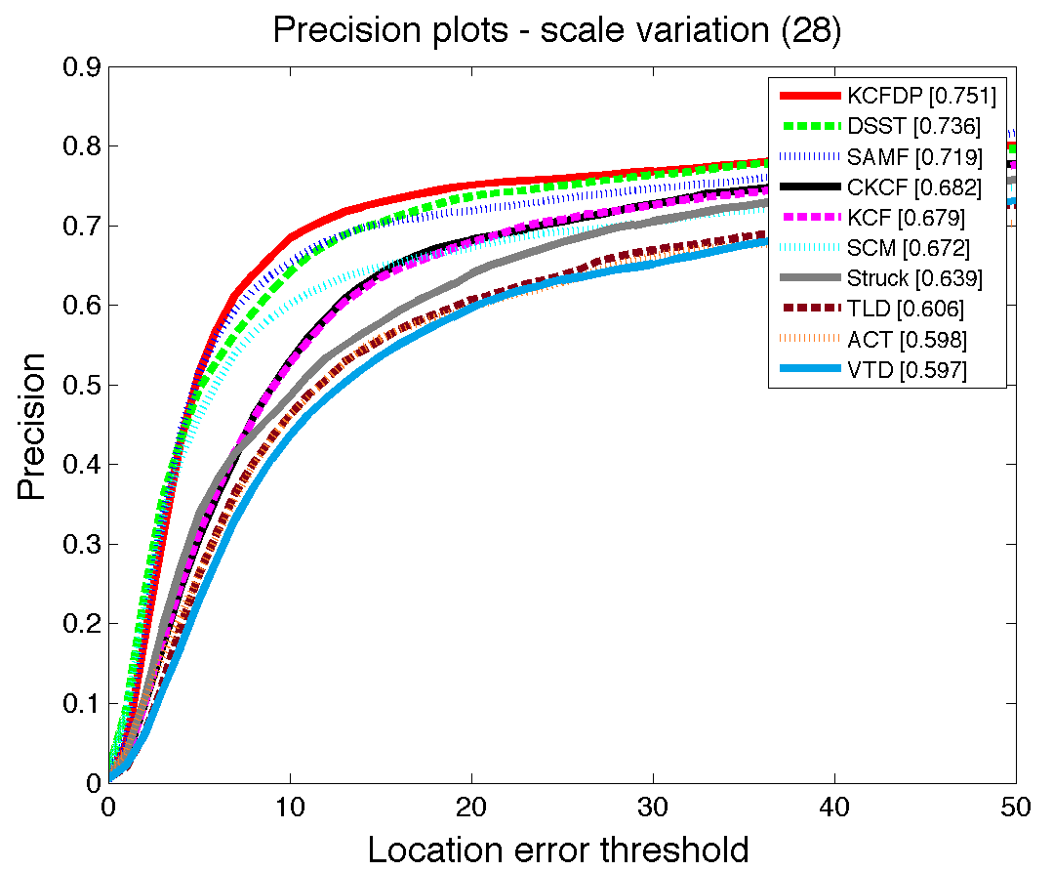
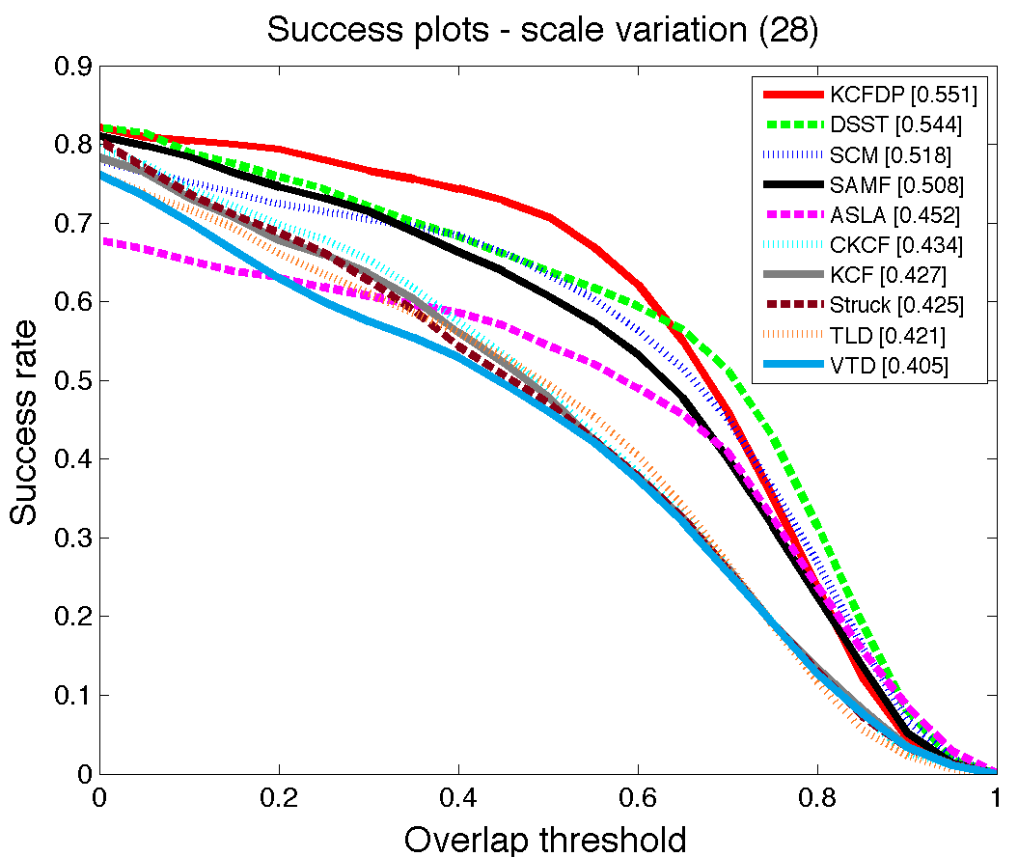
Evaluation
Scale adaptability of KCFDP
Avg % of frames with center location error < threshold
Ranked at 20 pixels
Avg % of frames with IoU > threshold
Ranked using Area Under Curves
CLE
IoU
Notes:
-We name our tracker Kernelized Correlation Filter with Detection Proposal, or “KCFDP”, and firstly evaluate its scale adaptability using the 28 scale variation sequences.
-the left figure is used to compare the location precision/prɪ'sɪʒn/ of trackers. x axis denotes different center location error thresholds. The target is successfully tracked in a frame if the distance between the detected center and ground truth center is smaller than the threshold. And here the y axis denotes the average percent of successful frames.
-the right figure is used to compare the overlap ratio between the tracking result and ground truth. x axis now denotes different IoU thresholds. If the intersection area of the tracked target and ground truth box divided by their union area is larger than the threshold, the target is considered as successfully tracked.
-In both figures, our tracker outperforms all the other trackers, which proves its superior scale adaptability.

Slide 23
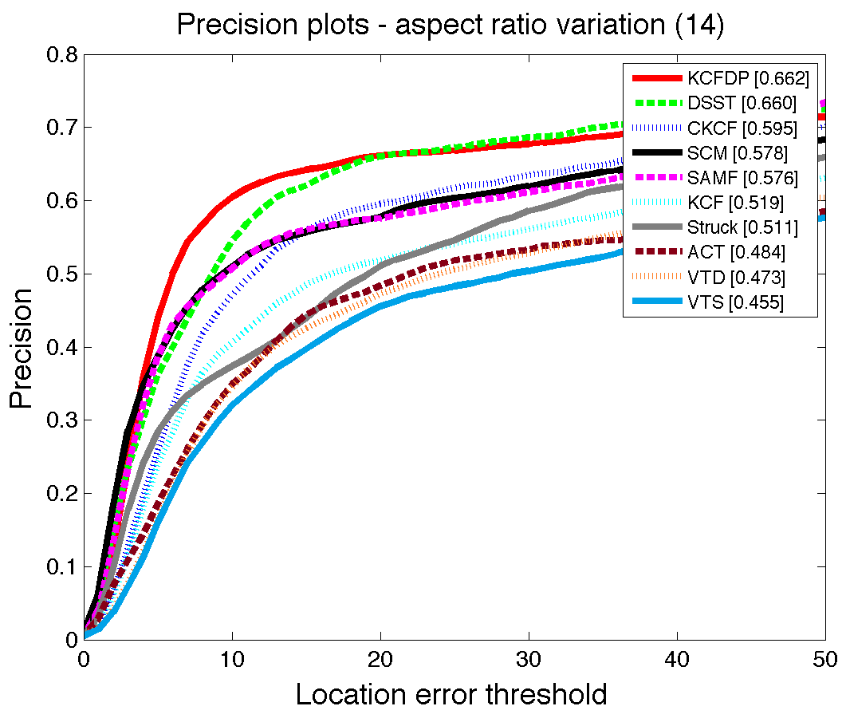
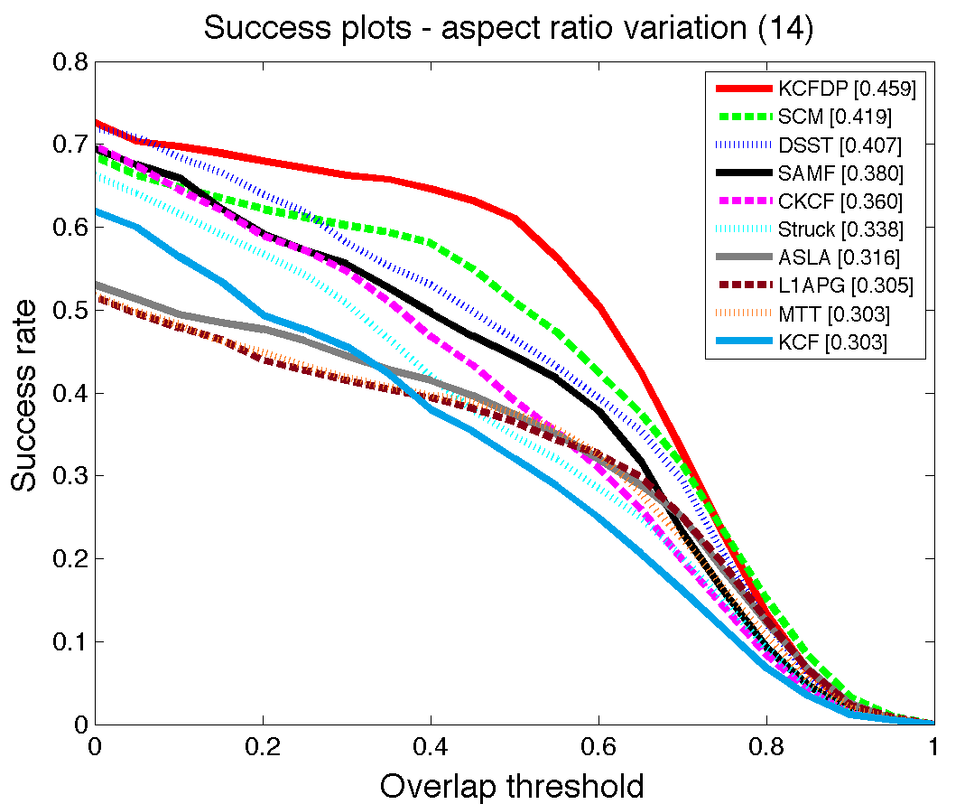
Evaluation
Aspect ratio adaptability of KCFDP
Avg % of frames with center location error < threshold
Ranked at 20 pixels
Avg % of frames with IoU > threshold
Ranked using Area Under Curves
CLE
IoU
Notes:
-Similar experiment is conducted on the 14 aspect ratio variation seqs.
-Although/ɔl'ðo/ in the left figure, KCFDP shows negligible/'nɛɡlɪdʒəbl/ superiority comparing to the second place, the boost in overlap ratio can be clearly perceived in the right figure. Which proves that the aspect ratio adaptability is dramatically/drə'mætɪkli/ improved.

Slide 24
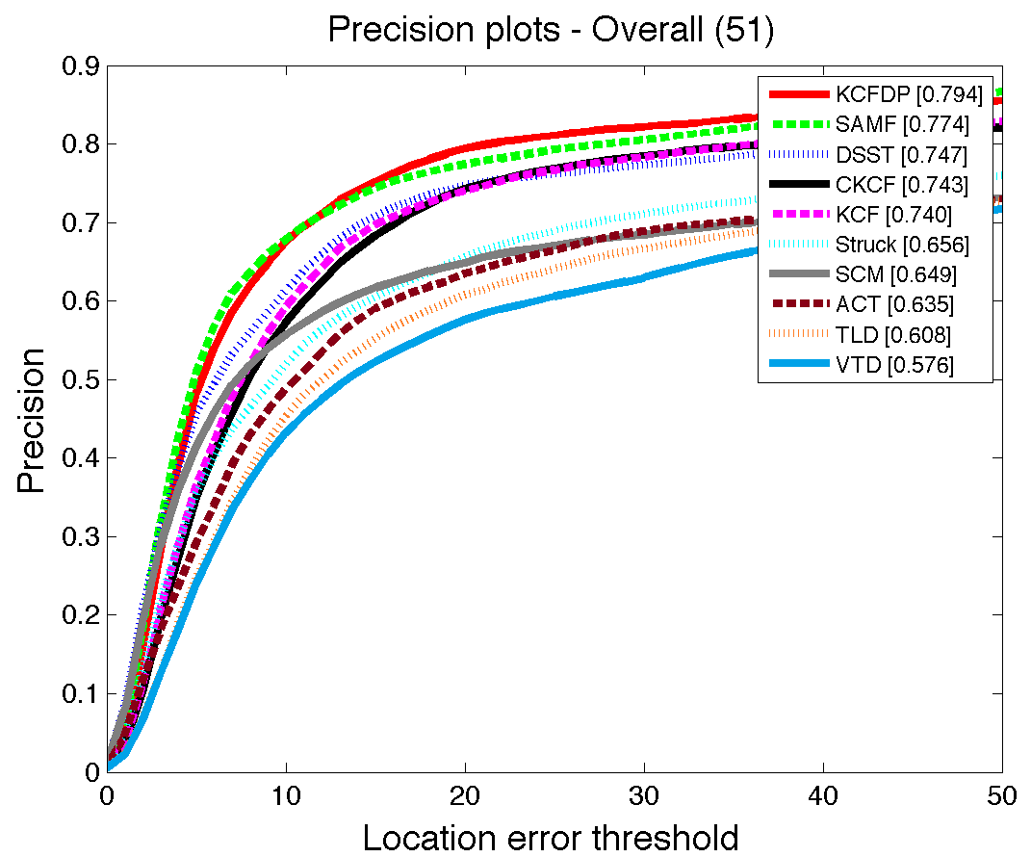
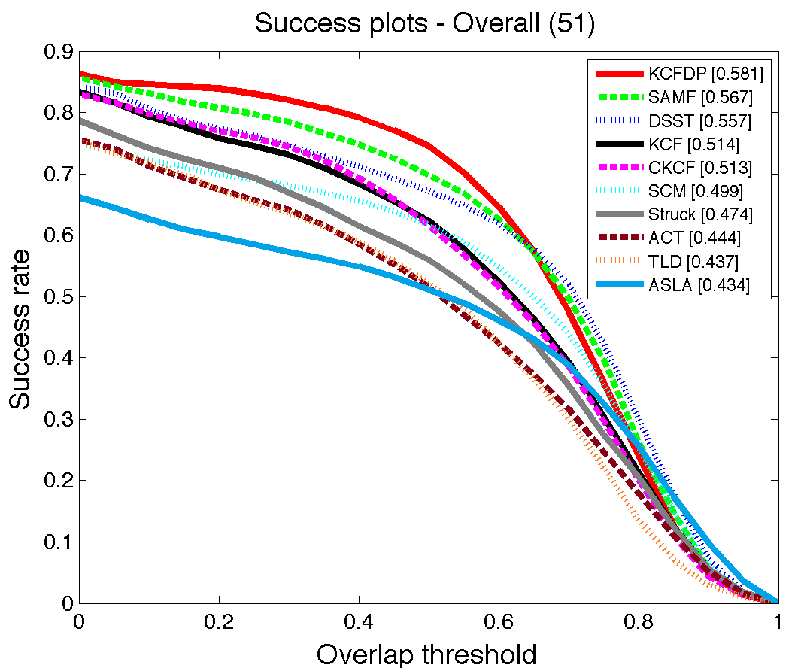
Evaluation
Overall
Average speed: 20.8 FPS on Intel i5-4278U CPU
Notes:
-we also set up a comparison on the whole 50 sequences, where our tracker also takes the first place.
-What’s more, our tracker implemented in matlab can run at an average speed of 20.8 FPS on a laptop, which clearly exhibits the efficiency of our method.

Slide 25
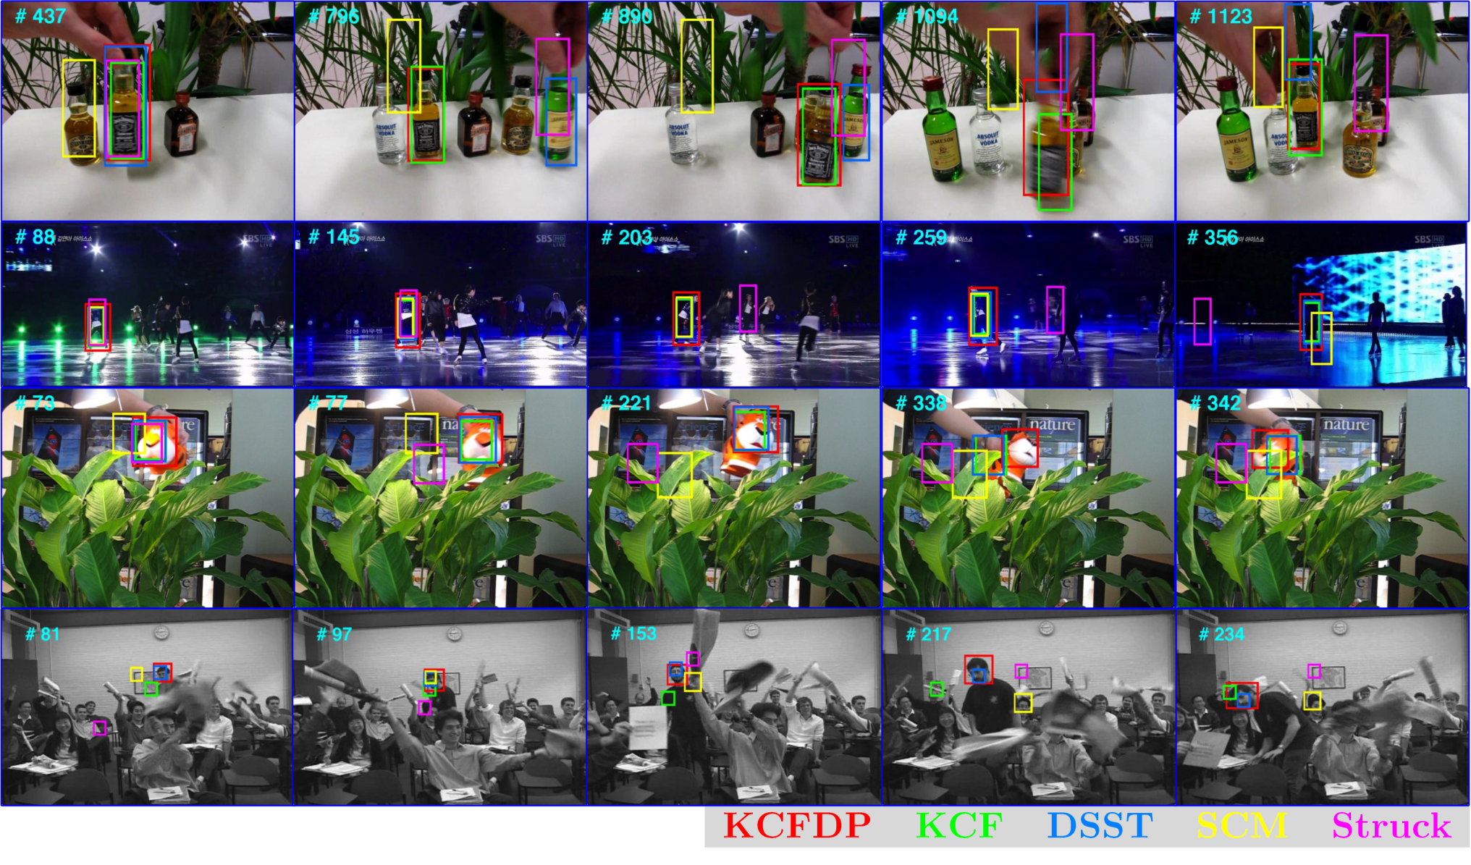
Evaluation
Samples
Notes:
Finally, here are some visualized comparisons of our tracker with four state-of-the-art trackers.
Even in these challenging scenarios, our method still tracks the target and adapts to the size variation accurately.

Slide 26
Summary
Correlation filter tracker is a very efficient kind of discriminative tracking method.
Class-agnostic detection proposals can provide flexible and promising tracking candidates (as a supplement to motion models).
More flexible candidates require more robust correlation filter (or other observation models) and more precise object description.
Thanks for your attention!
Notes:
That’s all of my report, thank you very much.

